Slide 1
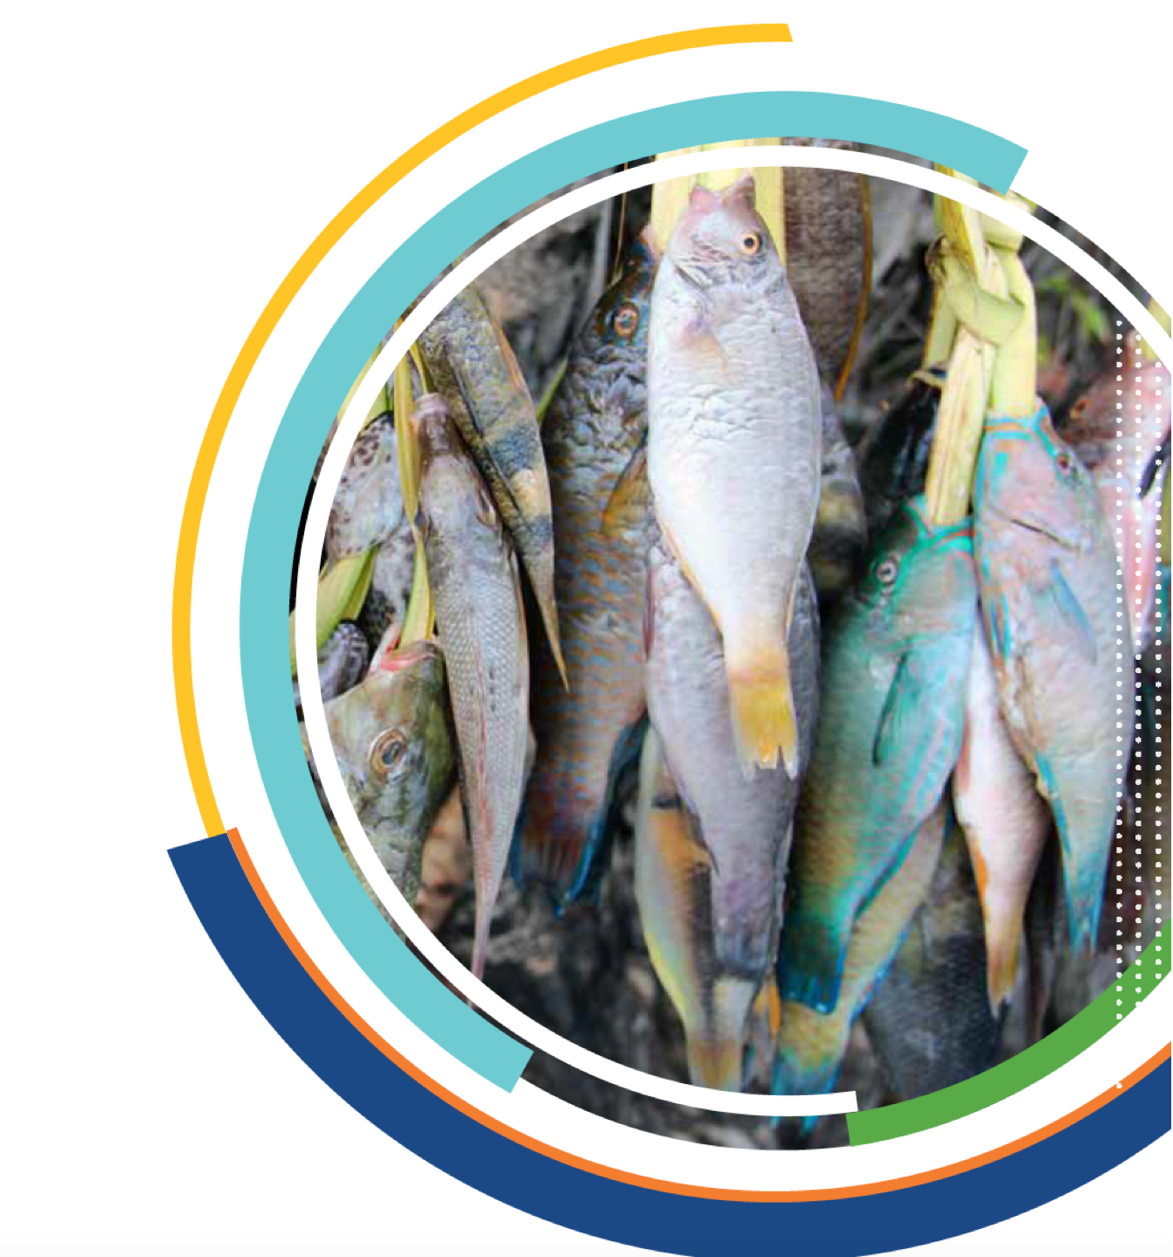

WorldFish
AN INTRODUCTION

Slide 2











FOREWORD
Aquatic foods must occupy a central place
in the global agricultural research agenda, which has traditionally focused
on land-based crops
and livestock.
This task is critical to ensure a full representation of the
food system, address the complex links among food, land and water systems,
and unlock an ocean of opportunities in an emerging blue economy that must
prioritize social inclusion and equity.

Slide 3

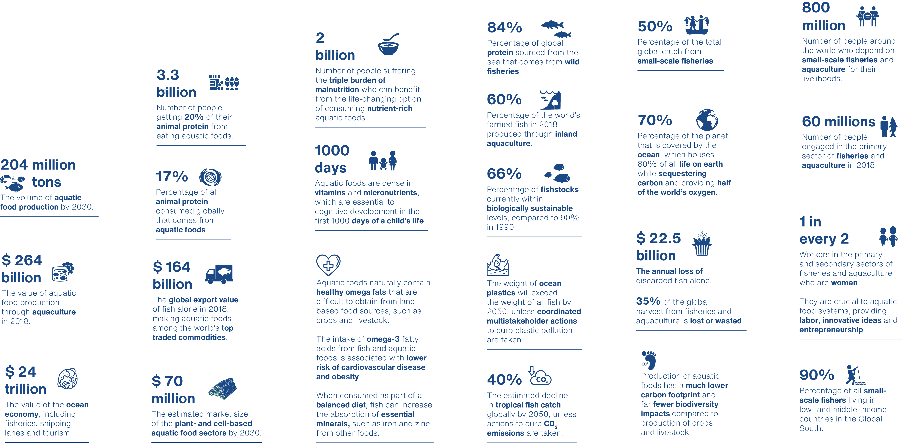
The big facts ON AQUATIC FOODS
Source: FAO (2019), Costello et.al (2019), WorldFish (2020)

Slide 4
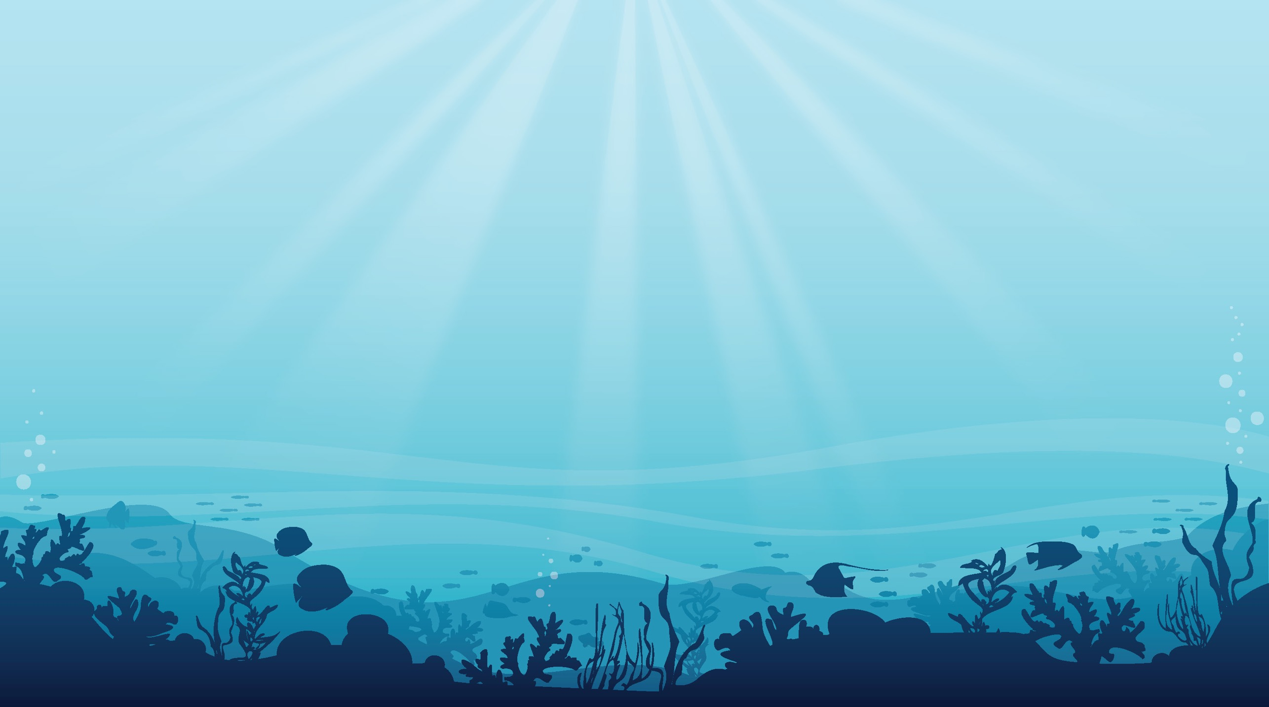
Part I
Responding to change

Slide 5

Our blue planet
IS CHANGING
Through science, we will help to illuminate sound paths toward a sustainable food systems transformation with aquatic foods and to meet the goals of the 2030 Agenda for Sustainable Development in all three of its dimensions—social, economic and environmental.

Slide 6
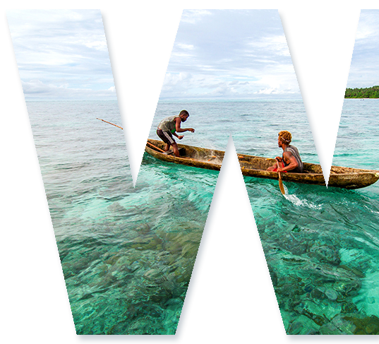

Our Vision
An inclusive world of healthy, well-nourished people and a sustainable blue planet, now and in the future.
Our Mission
To end hunger and advance sustainable development by 2030 through science and innovation to transform food, land and water systems with aquatic foods for healthier people and planet.

Slide 7
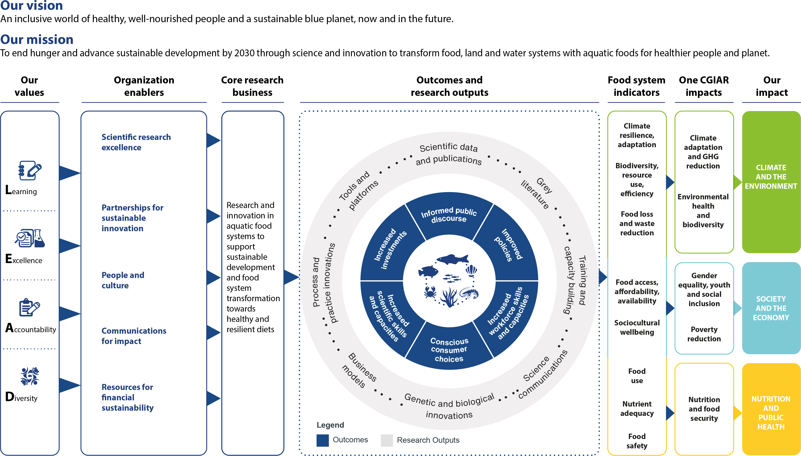
Our strategy AT A GLANCE

Slide 8






What are
AQUATIC FOODS?
Aquatic foods are aquatic animals and plants grown in or harvested in the wild from water for food or feed, and their synthetic substitutes.
Finfish
Shellfish
Aquatic plants
Aquatic feeds
Other
aquatic foods
Synthetic substitutes

Slide 9
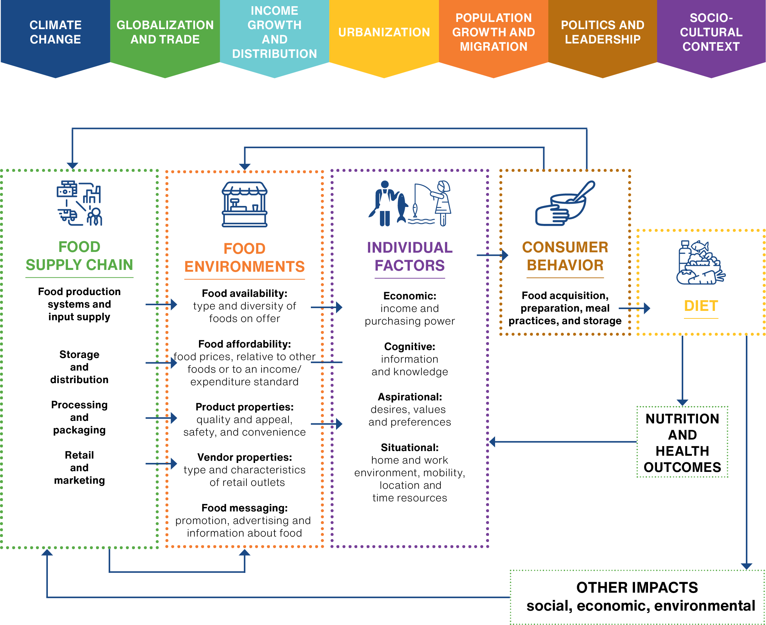
What is an
aquatic
FOOD
SYSTEM?

Slide 10
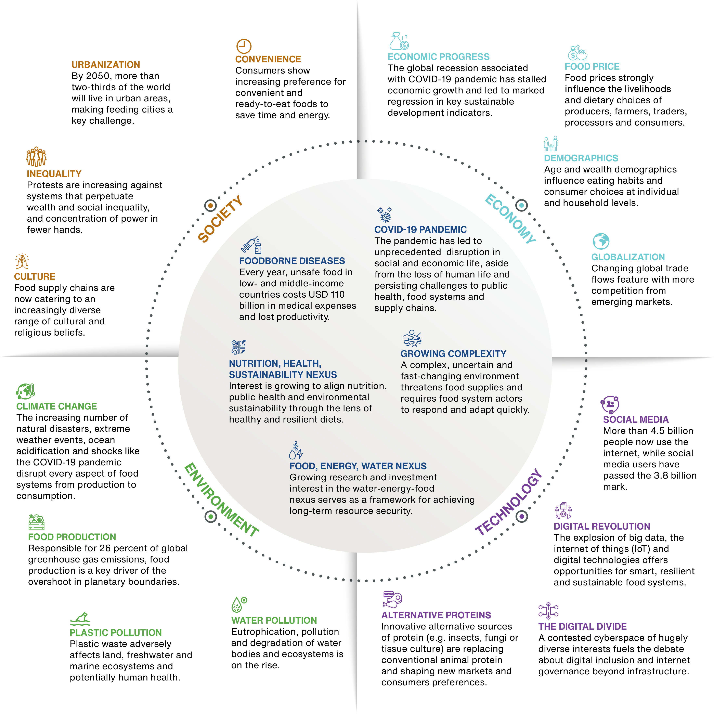
Global trends
AFFECTING
FOOD SYSTEMS
The evolving global context demands a
systems transformation approach for food,
land and water systems.

Slide 11
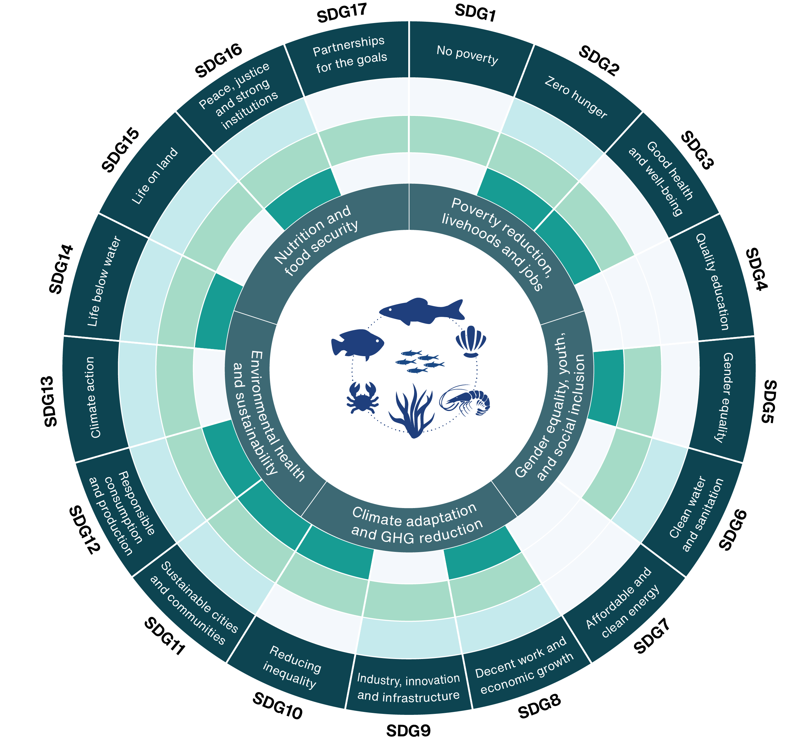
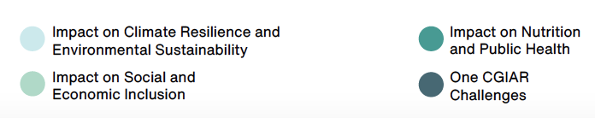
Tackling
global challenges
WITH AQUATIC FOODS
Aquatic foods, alongside land crops and livestock, are a significant part of the equation for healthy and sustainable diets within our planetary boundaries.

Slide 12
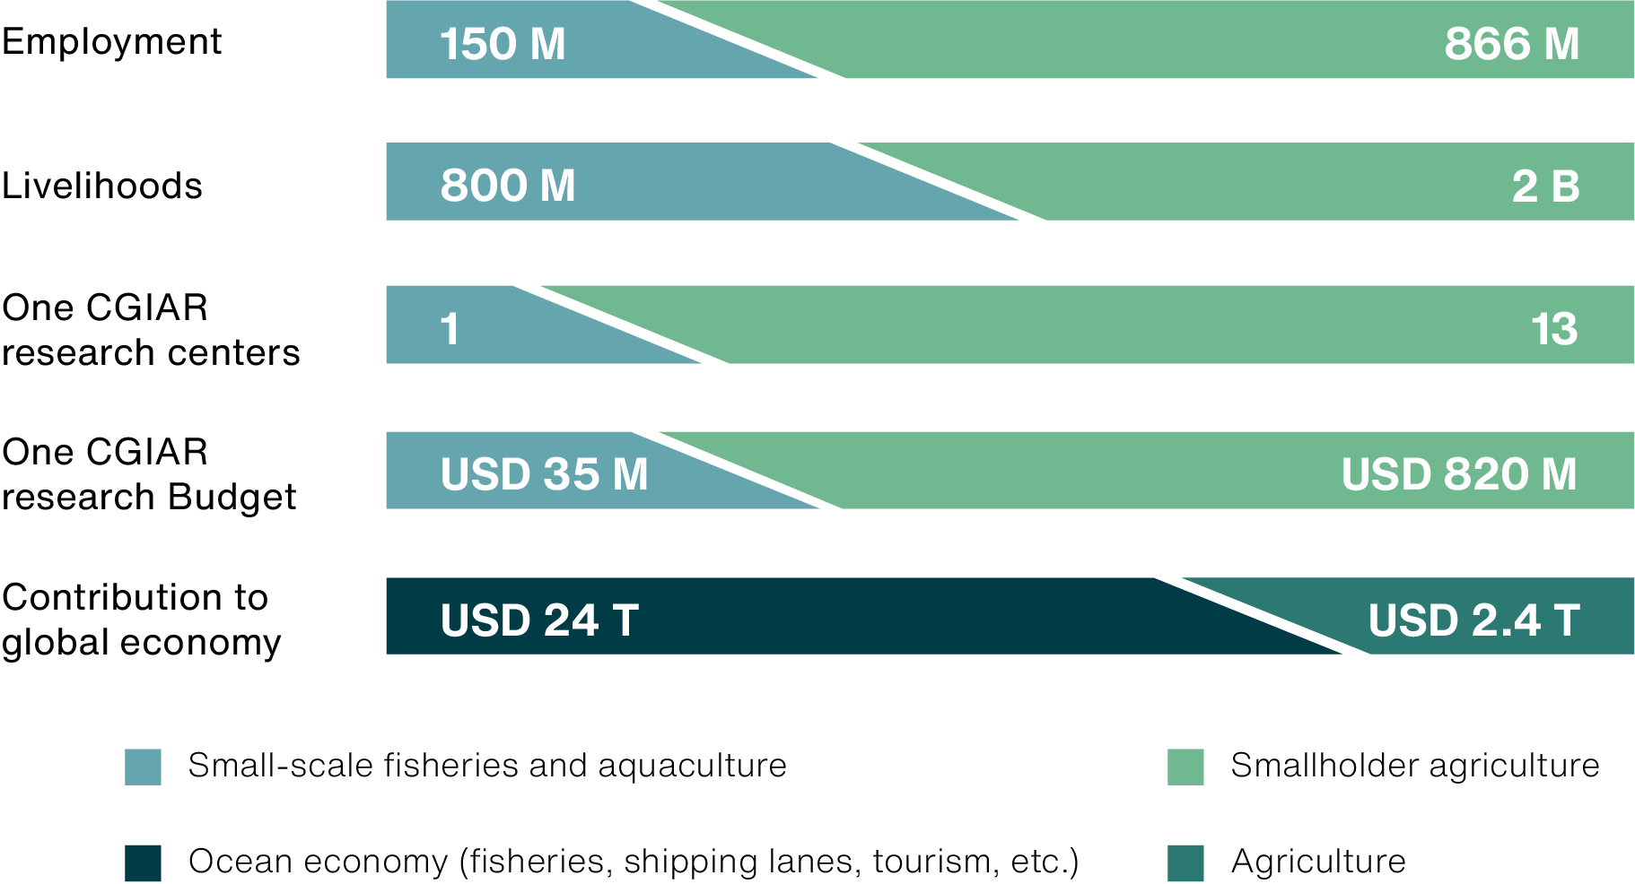


Our unique
PROPOSITION
Aquatic foods offer a viable nutritious and sustainable alternative that is traditionally overlooked in the global agricultural research agenda, which supports sustainable development at country and global levels.
Aquatic foods are
rich in numerous
vitamins, minerals,
omega-3 fatty acids
and micronutrients
essential to cognitive
development and
human health.

Slide 13
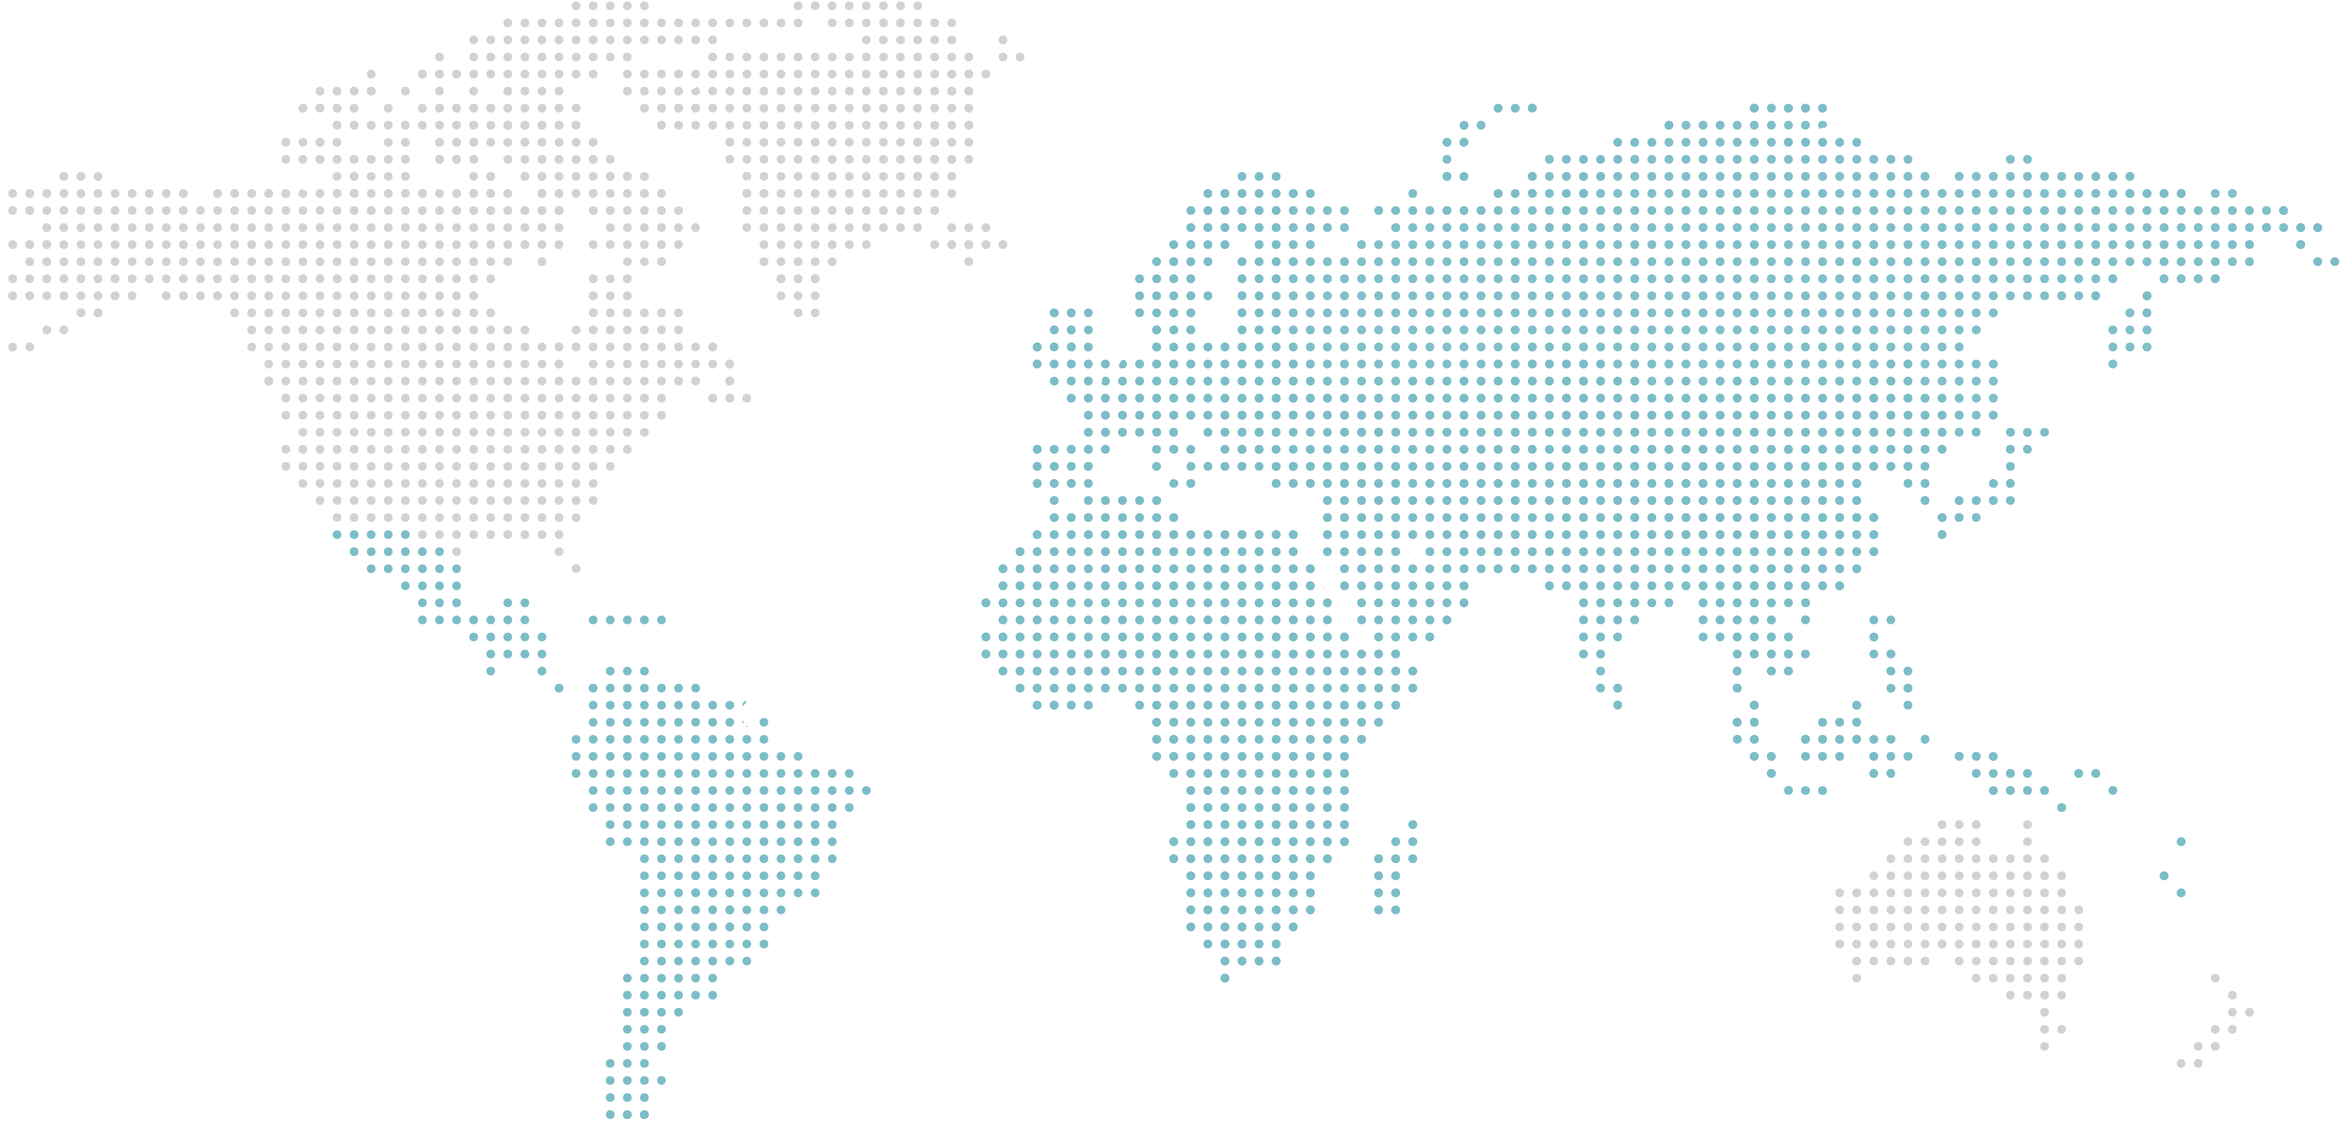


90%
Percentage of the global production
of farmed aquatic foods that comes from Asia.
Focus
geographies
AND COMMUNITIES
3000
Number of fish species in
the Amazon basin alone, representing one in every 10 freshwater fish
caught worldwide.
$ 24 billion
Direct contribution of
aquatic food systems to the African economy, as well as to food security and nutrition.
50%
Percentage of all households in the Pacific that depend on coastal fisheries for their primary or secondary income.

Slide 14









Who benefits
FROM OUR WORK
Small-scale fishers,
farmers, producers,
processors, traders
and consumers
Local community and development actors
Scientific community
in low- and middle-income countries
Public sector
Private sector
One CGIAR
Media and the general public
Young scientists, innovators and entrepreneurs
Investors, philanthropic actors and development agencies

Slide 15
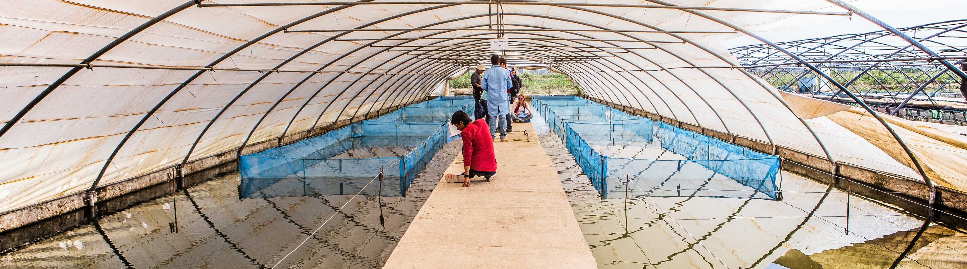
PART II
A transformative agenda
for research on aquatic food systems

Slide 16







The untapped potential of AQUATIC FOODS
Aquatic food systems are an extremely important but historically undervalued component of the global food system and their role in improving nutrition and sustaining healthy diets (Thilsted 2016).
Environment
Livelihoods
Nutrition

Slide 17


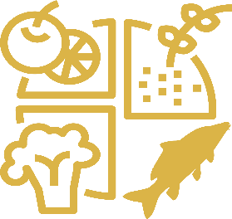
Research priorities
FOR ACTION
IMPACT: CLIMATE RESILIENCE AND ENVIRONMENTAL SUSTAINABILITY
  1.1 Enable sustainable production of diverse aquatic foods
  1.2 Cut down on loss and waste
  1.3 Enhance climate resilience and reduce greenhouse gas emissions
2. IMPACT: SOCIAL AND ECONOMIC INCLUSION
  2.1 Leave no one behind with an inclusive and people-centered blue economy
  2.2 Improve the availability, accessibility and affordability of aquatic foods for all
  2.3 Support sustainable livelihoods, decent work and well-being
3. IMPACT: NUTRITION AND PUBLIC HEALTH
  3.1 Inform consumer demand for healthy and nutritious aquatic foods
  3.2 Ensure aquatic foods are safe and healthy for human consumption
  3.3 Prioritize nutrition and health for vulnerable and marginalized people

Slide 18
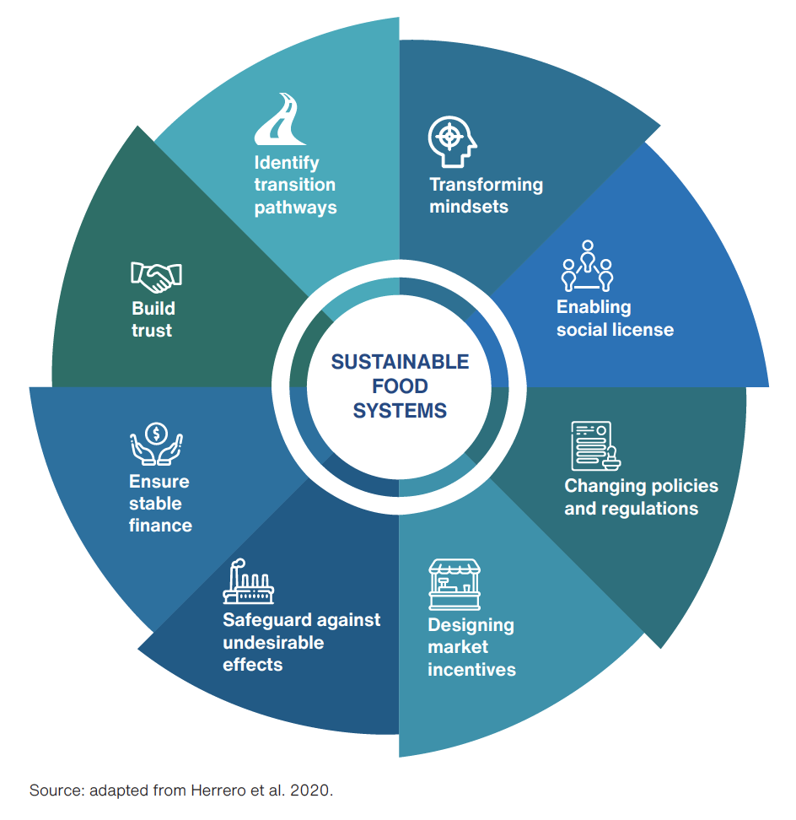
Increasing
THE SPEED
OF INNOVATION
We recognize that transformative change
requires our work to be situated within
an innovation ecosystem of partners,
stakeholders, networks, assets and institutions
to turn research into demand-driven products,
services and solutions at scale.

Slide 19



Accelerating transformation
WITH AQUATIC FOODS FUTURE
Aquatic Food Futures Lab
to spark innovation
and social change
Fish for Africa Innovation
Hub
A Global Index on Aquatic Foods and flagship publication

Slide 20
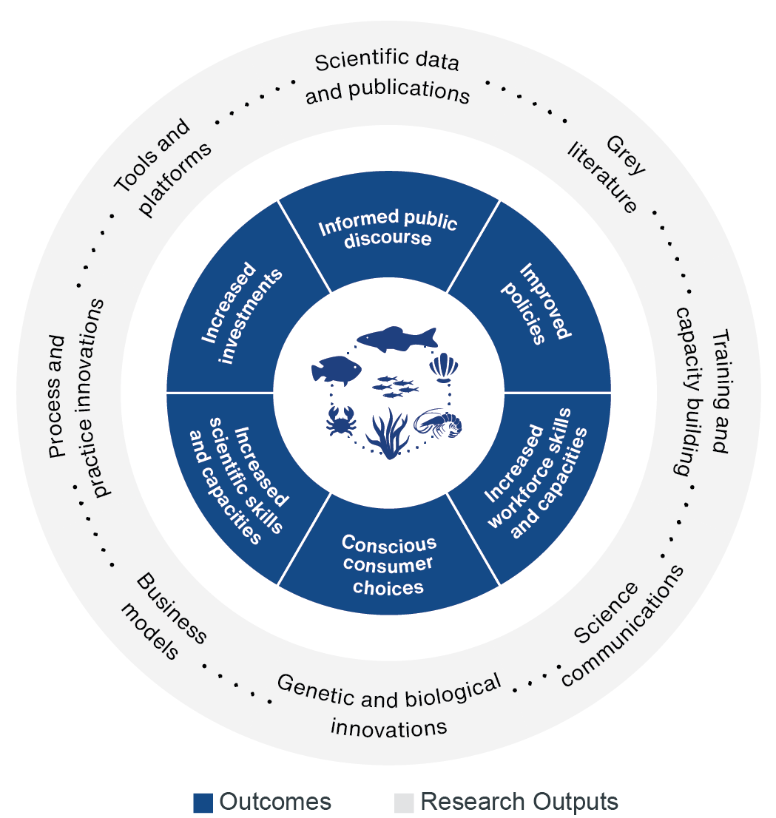
From research
TO OUTCOMES AND IMPACT
Our 10-year institutional strategy for research on aquatic food systems to 2030 provides a guiding framework for exploring and identifying sustainable food systems transformation approaches and scenarios at the intersection of research, technology, policies, markets and social innovations across different disciplines and sectors.

Slide 21





Results-based management for
LEARNING, ACCOUNTABILITY
AND IMPACT
Strategic management
Accountability and learning management
Operational management
Change management
Responsibility management

Slide 22
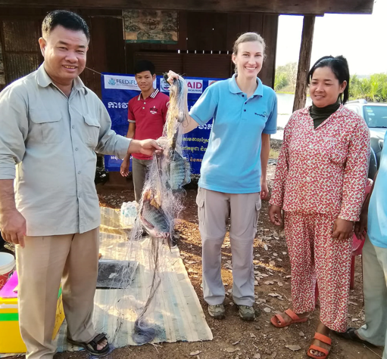
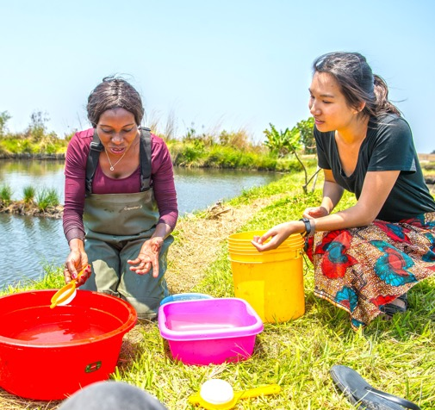
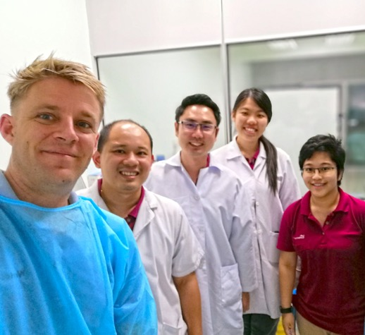
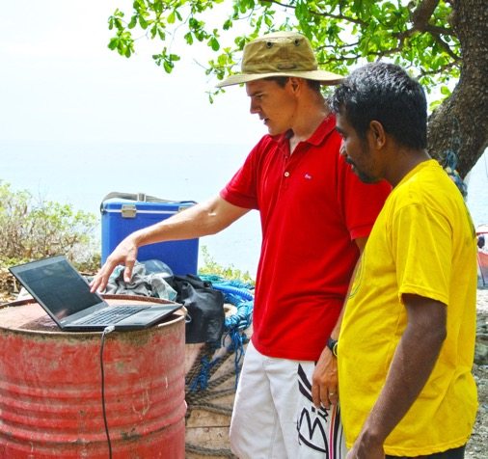
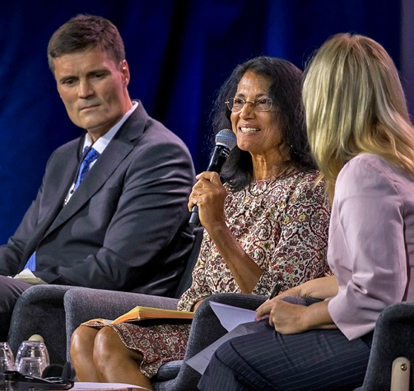
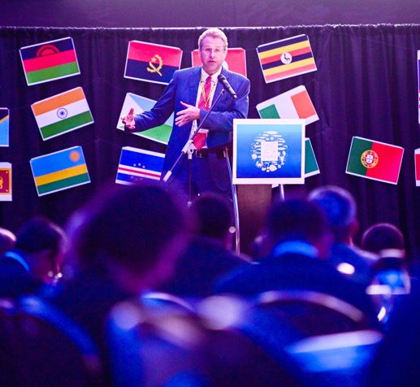
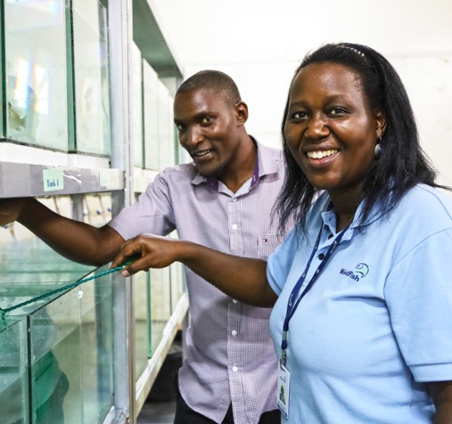
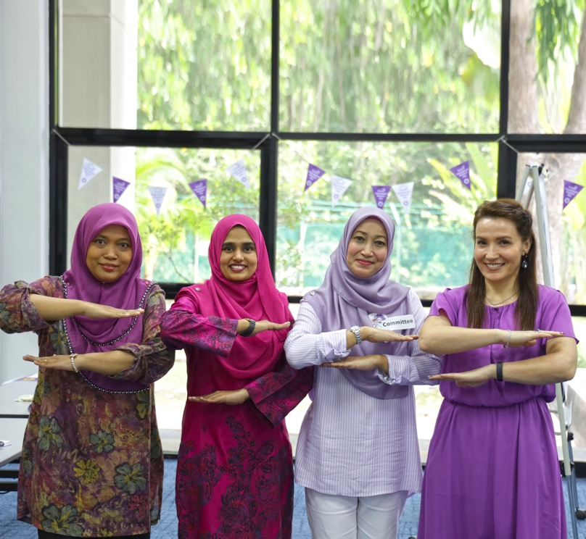

PART III
A change
agenda for organizational transformation

Slide 23
Our values
We recognize that our scientific work and impact in the world is enhanced when we bring together a diversity of backgrounds, skills, disciplines, talents and partnerships that inform the way we work and shape our organizational culture and workplace, as well as our aspiration to be a global thought leader.
Learning
Excellence
Accountability
Diversity
L
E
A
D

Slide 24
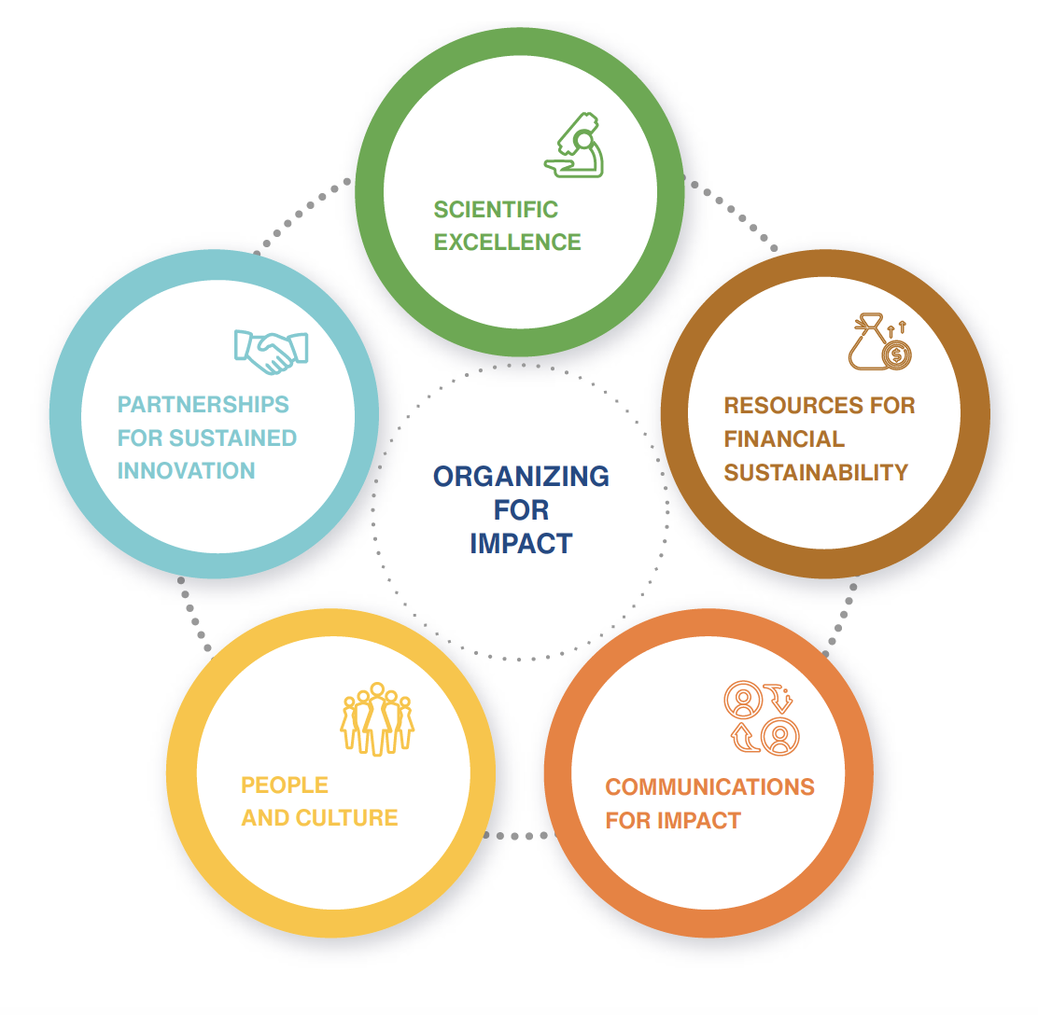
Organizing
FOR IMPACT
In order to transform ourselves into a world-class research and innovation organization fit for the fast-paced change of the 21st century, we have identified five critical organization enablers which entail a set of commitments under each.
.

Slide 25
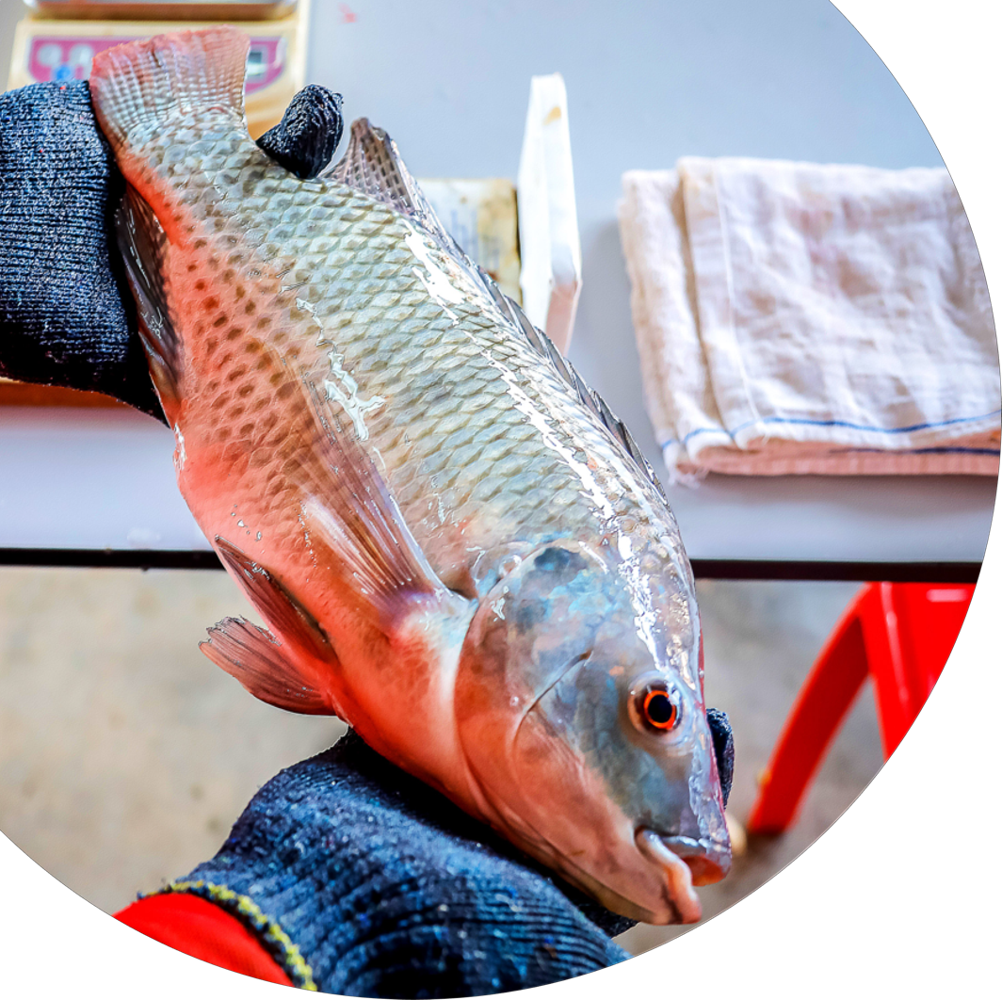



Scientific
RESEARCH EXCELLENSE
Our philosophy and practices on scientific research will be guided by three key commitments.
Research excellence
Research growth
Research impact and influence

Slide 26
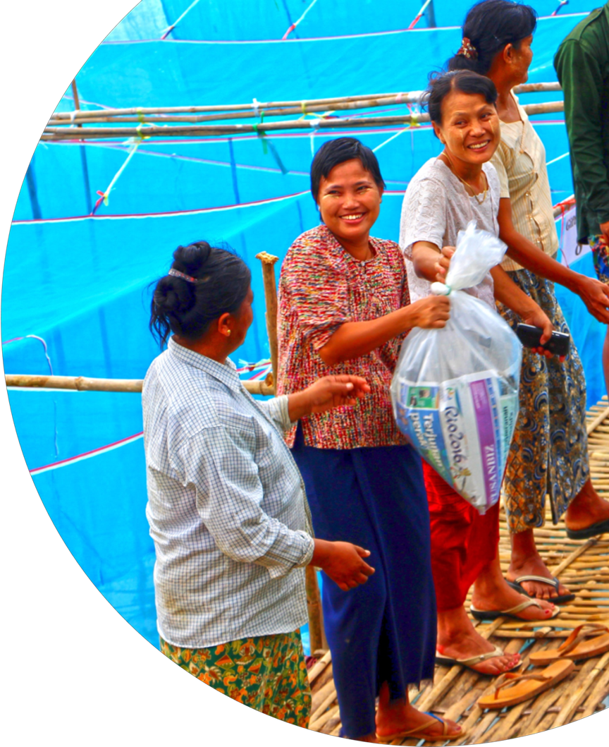





Partnerships
FOR SUSTAINED INNOVATION
Over the next 10 years, we aspire to build and nurture a global movement of partners and stakeholders across the public and private sectors.
Mission and impact-oriented partnerships
Innovation ecosystem
of partners
Business development
and entrepreneurship

Slide 27
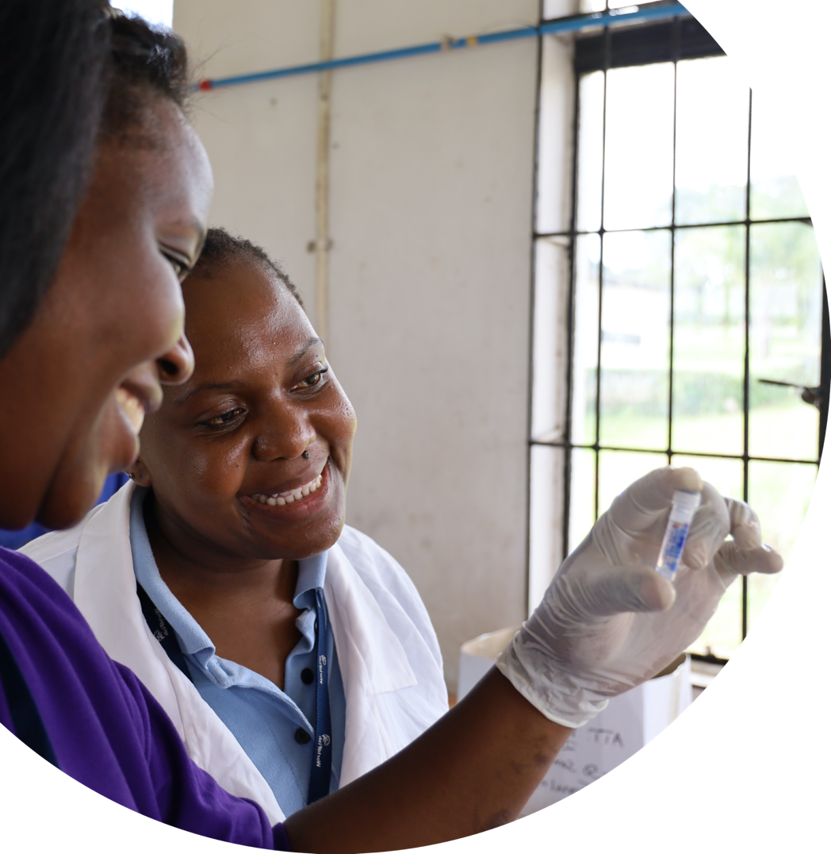



People
AND CULTURE
As part of One CGIAR, we are committed to fair, safe and inclusive workplaces. Our diversity powers our innovation.
Attract and retain
high-performing talent
A high-performance culture with foundations on learning, growth and innovation
Gender, diversity and inclusion

Slide 28




Communications
FOR IMPACT
We will use evidence-based communications to make aquatic foods part of the conversation to address critical sustainable development challenges.
Advocacy and strategic outreach
Internal communications
Digital transformation

Slide 29
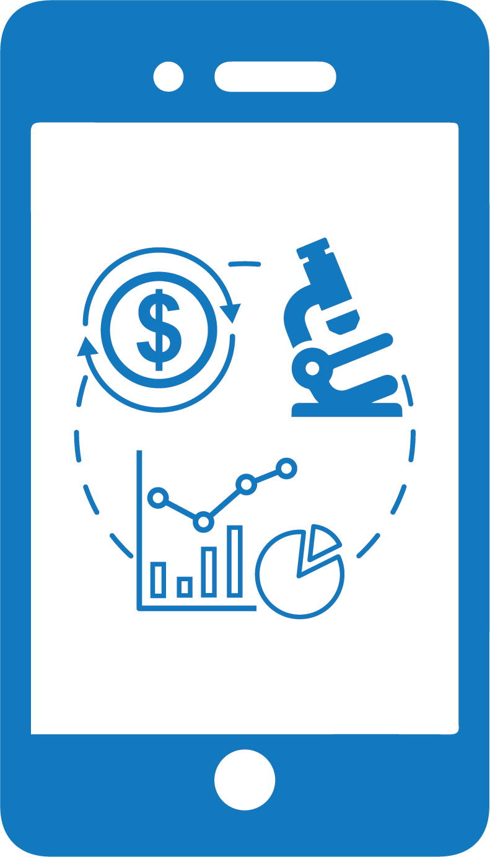





Resources for
FINANCIAL
SUSTAINABILITY
We recognize that effective mobilization and control over our resources underpins all our aspirations of success.
Long-term financial sustainability
Efficient and agile financial and business operations
State-of-the art
physical and
digital infrastructure
Minimize our carbon footprint and environmental impact

Slide 30











Building on
SOLID FOUNDATIONS
Our vision for this comprehensive 10-year institutional strategy for research on aquatic foods systems builds on our past achievements and accomplishments.
1975
Established as ICLARM
1994
Key Innovation First genetically improved farmed tilapia (GIFT) released.
2002
WorldFish: New brand name adopted.
2005
World Food Prize
Dr. Modadugu Vijay Gupta, is awarded for work on low-cost aquaculture through GIFT.
2011
Leads CGIAR Research Program on Aquatic Agricultural Systems (AAS).
2011
Key innovation Nutrition-sensitive aquaculture plays lead role in food systems management in Bangladesh
2012
Key innovation
Rice-field fisheries
management integrating
sustainable management of
water, rice and aquatic foods is developed by WorldFish and
adopted in Cambodia.
2013
Key innovation
Nutritional fish-based products adopted by women and children in the first 1000 days of life in low-income
households in Asia.
2018
Leads the CGIAR Research Program on Fish Agri-Food Systems (FISH)
2020
WorldFish amends its constitution to adopt the concept of ‘aquatic food systems’ as new strategic direction for multidisciplinary research partnerships.
2020
Policy engagement
Joins expert group to lead one of the five action
tracks to shape 2021 UN
Food Systems Summit.

Slide 31

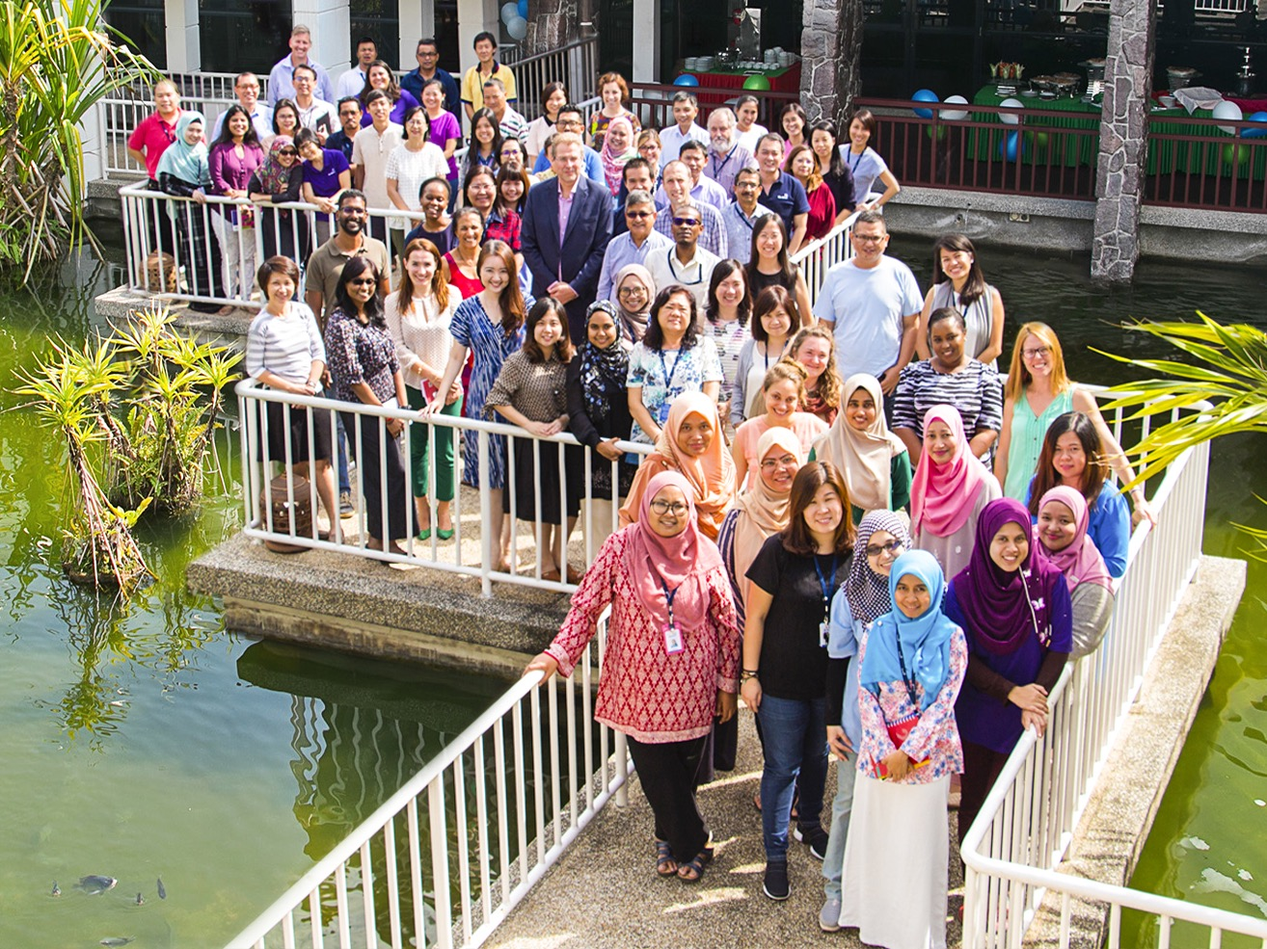

PART IV
Organization

Slide 32
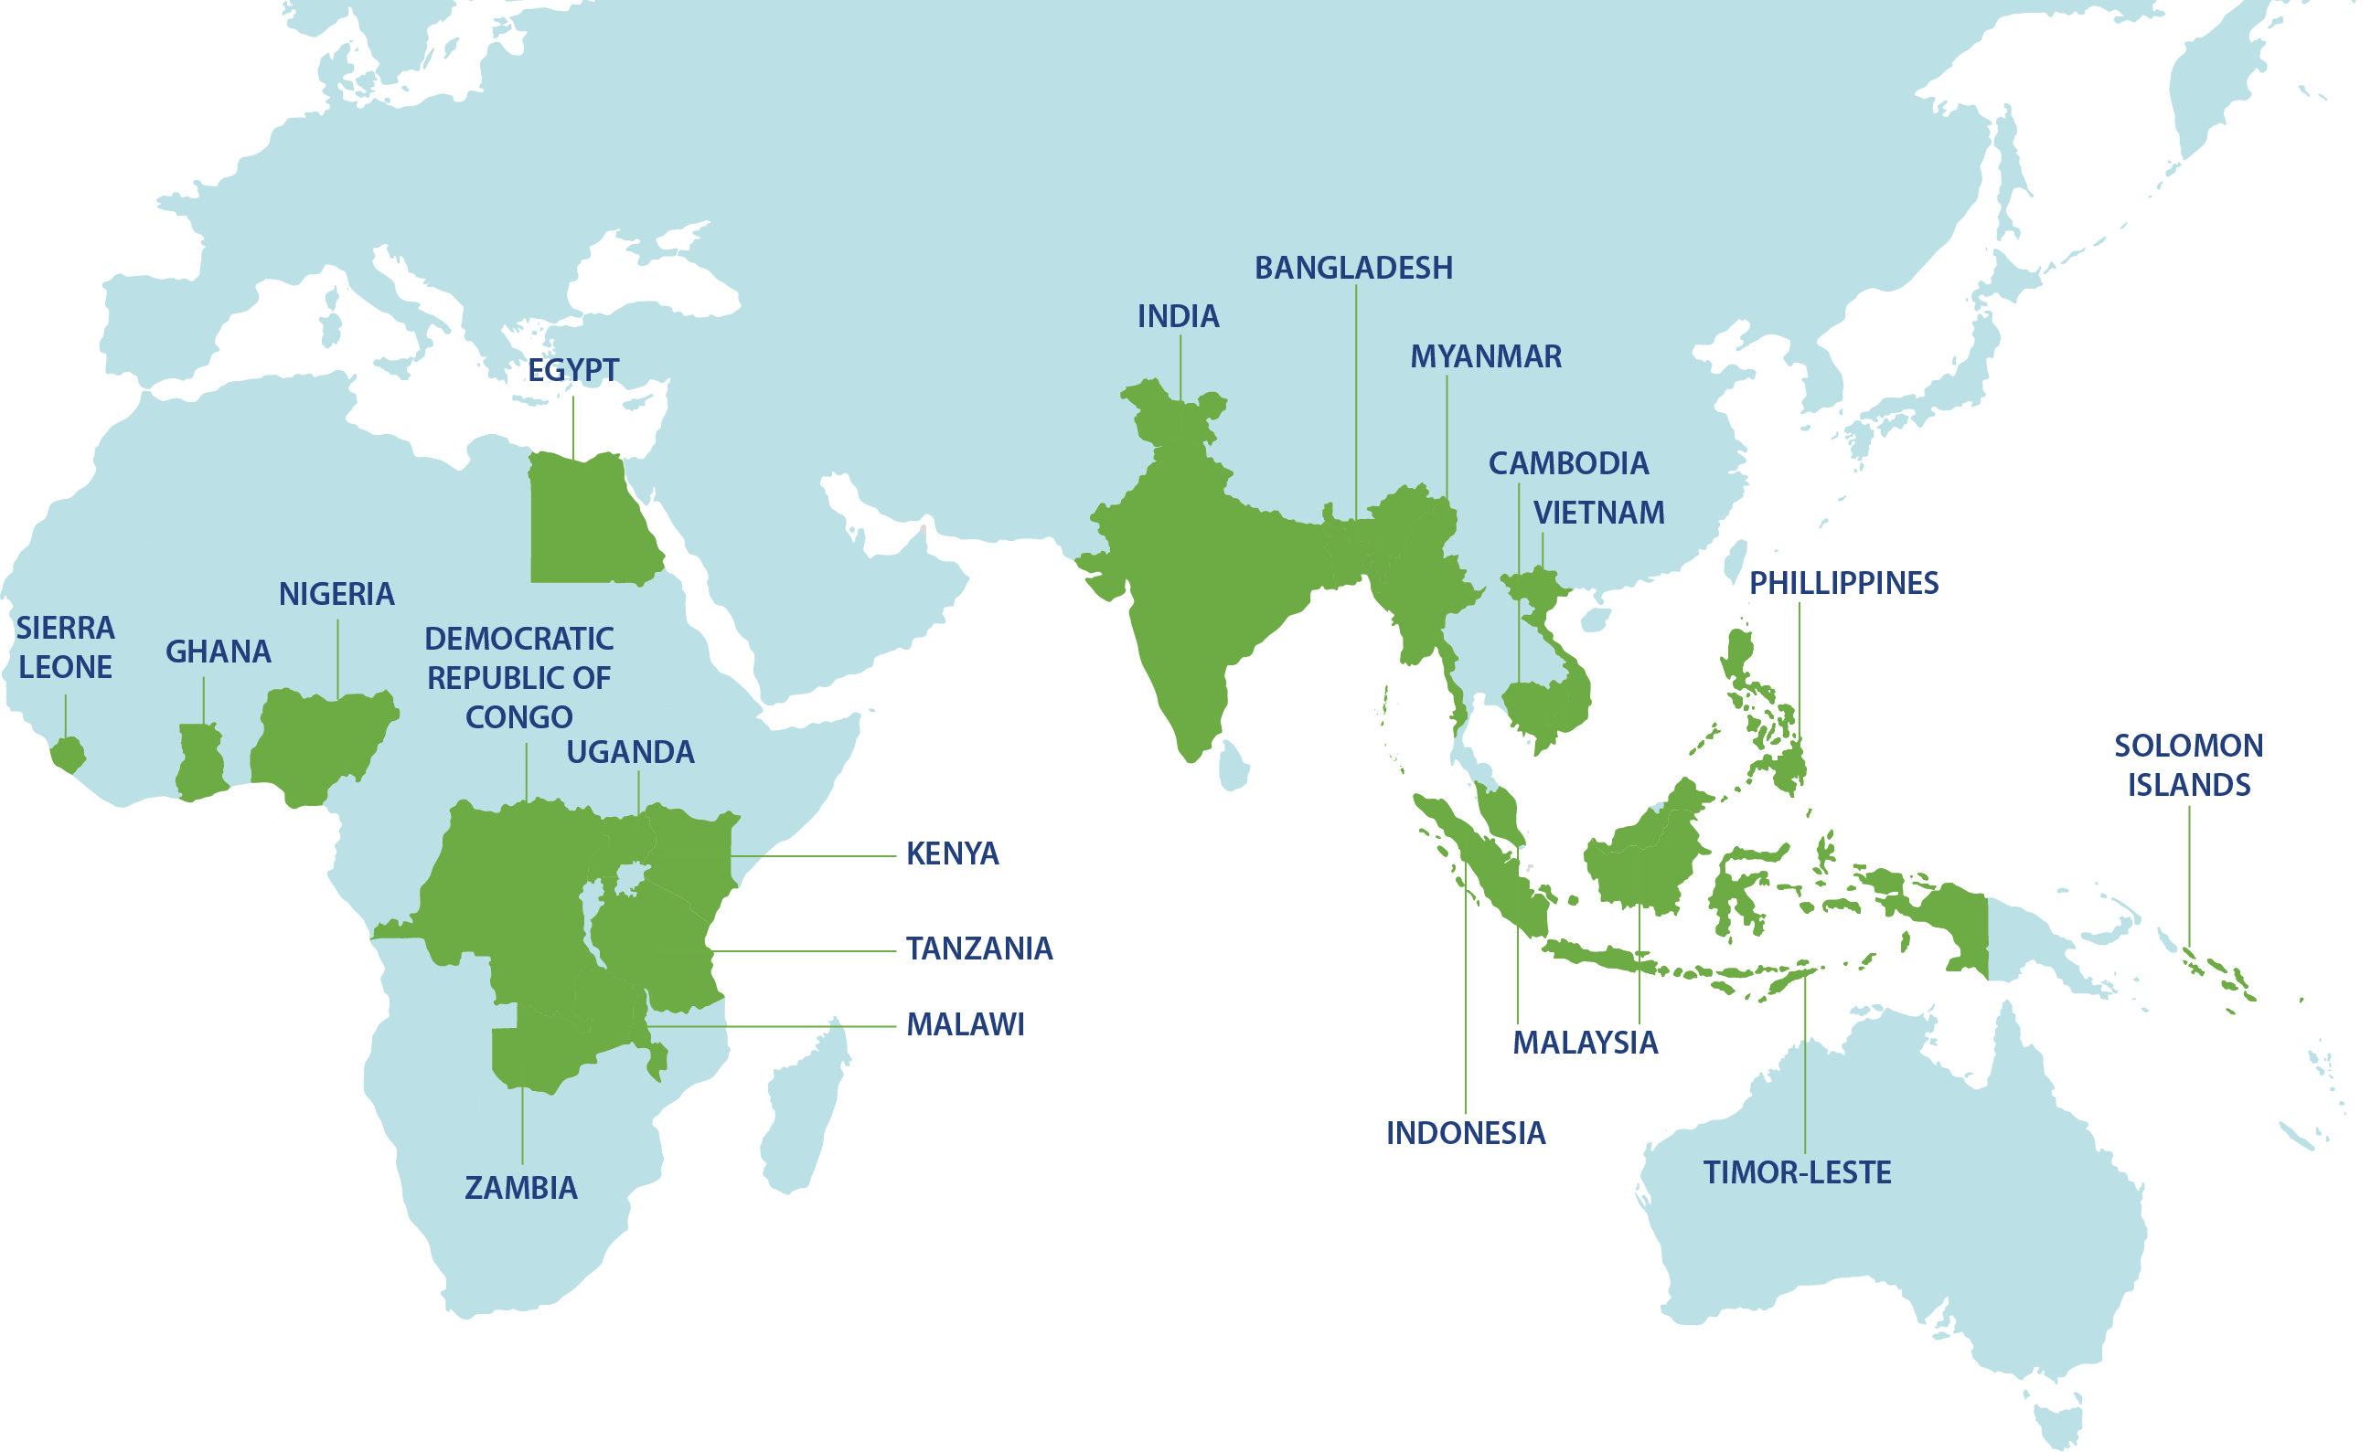
WHERE we are
WorldFish has a
global presence
in 20 countries
in 3 continents
with 446 staff representing
30 nationalities

Slide 33



Our
ORGANIZATION
We are driven by our LEAD values and strive to be a thriving and inclusive community of diverse people committed to learning and innovation, and with passion for making a difference in the world.
446
Total staff
36.8%
Percent of women on staff
59.2%
Percent of staff
who are working directly
in research
^{As of 31 October 2020}

Slide 34
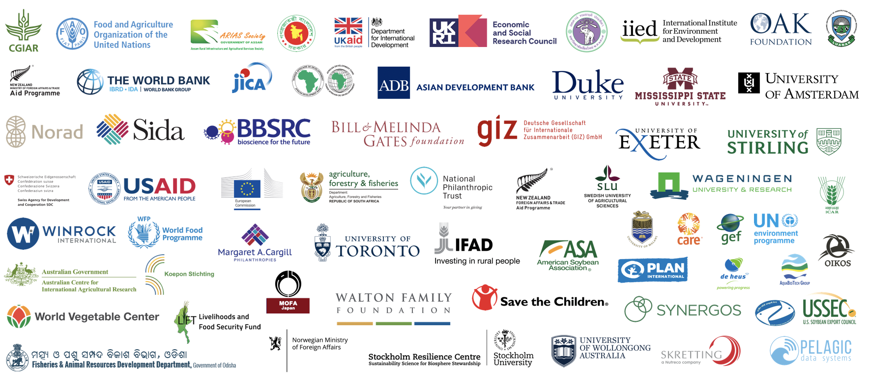

Our
INVESTORS

Slide 35
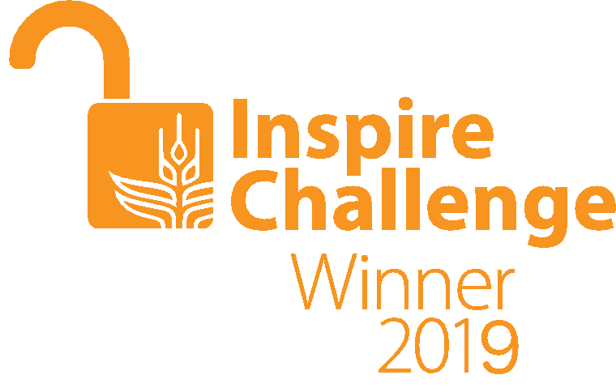
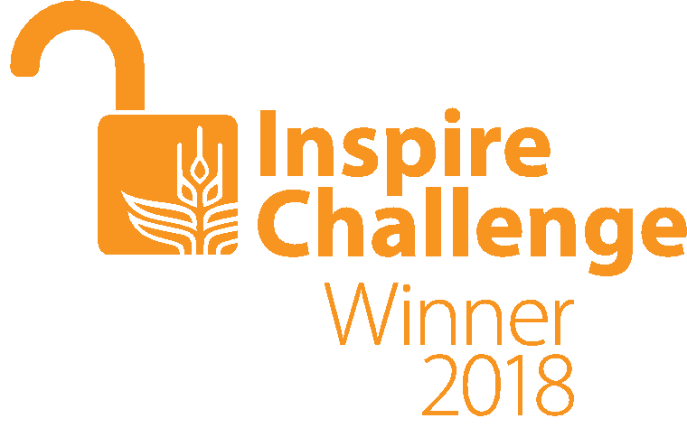
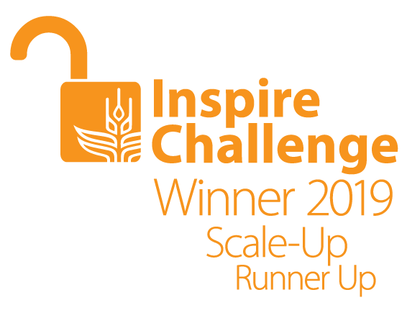
Our
AWARDS

Slide 36

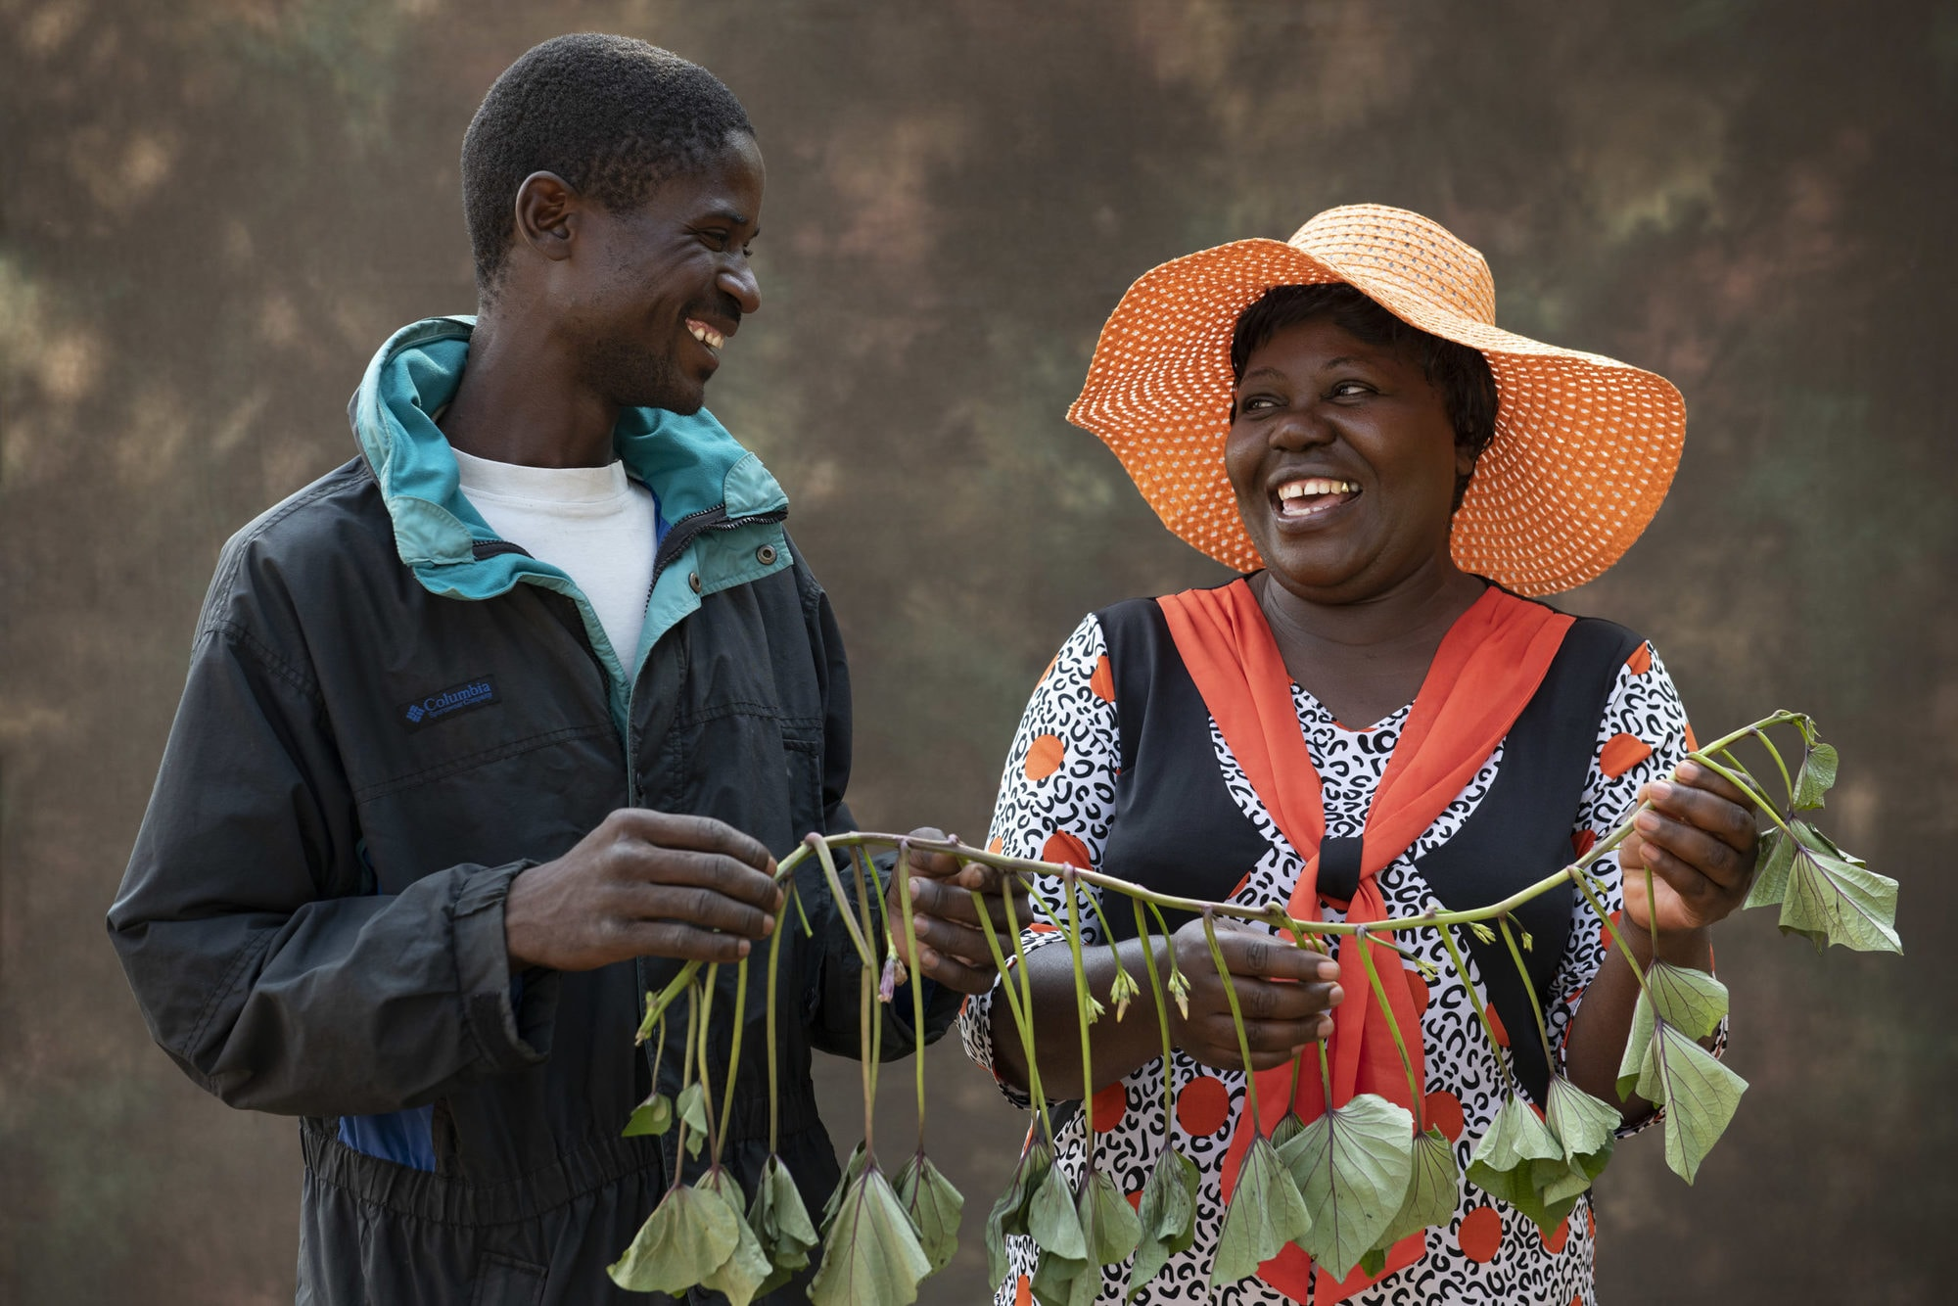



Slide 37
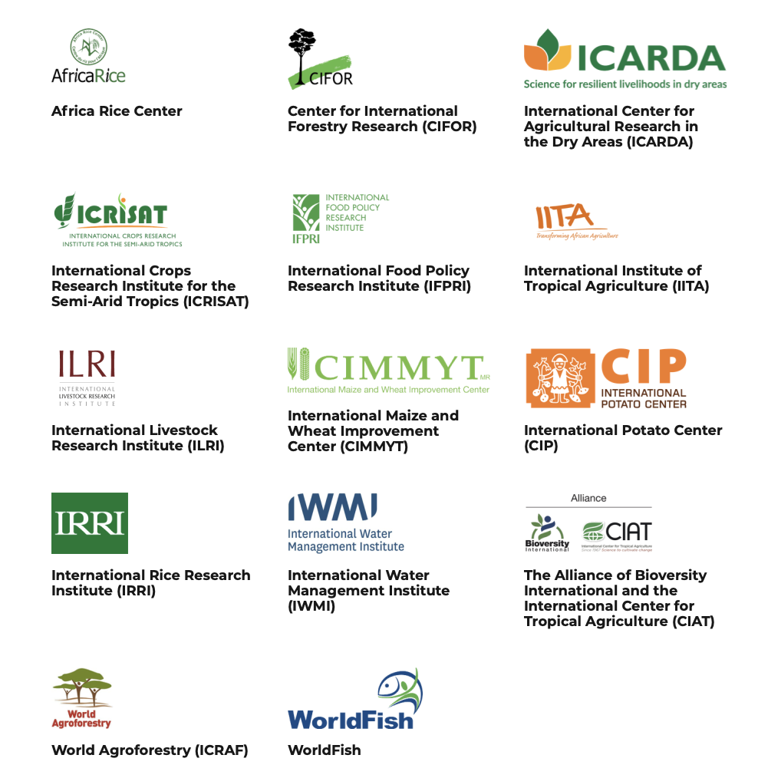
CGIAR
CGIAR is a global research partnership for a food secure future dedicated to reducing poverty, enhancing food and nutrition security, and improving natural resources.

Slide 38
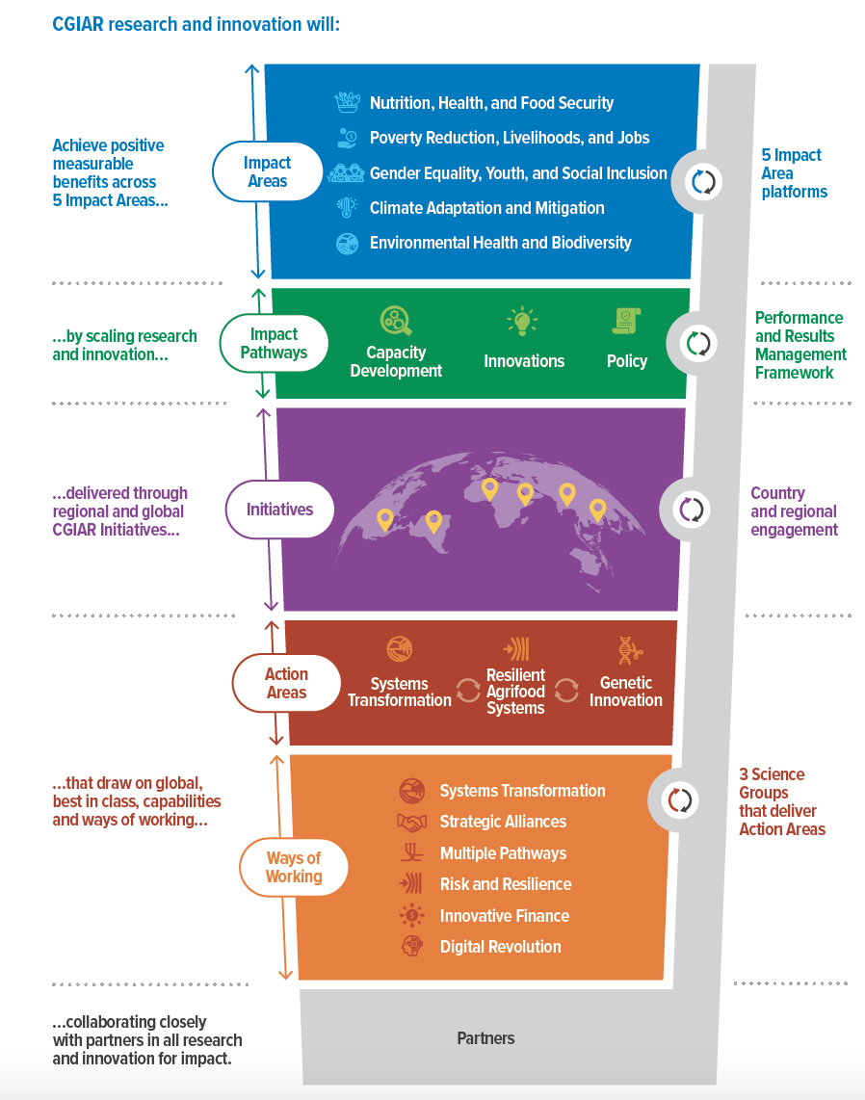
CGIAR
2030
Research and Innovation
Strategy
Transforming food, land, and water systems in a climate crisis

Slide 39
One CGIAR
Scientific innovations deployed faster, at a larger scale, and at reduced cost, having greater impact where they are needed the most.
A unified One CGIAR comprises of:
A sharper mission statement and impact focus to 2030, aligned with the Sustainable Development Goals (SDGs);
Unified governance under a ‘One CGIAR Common Board’;
Institutional integration, including more aligned management under an empowered Executive Management Team, common policies and services, and a unified country and regional presence;
A new research modality;
More, and pooled, funding.
“As the climate crisis escalates, there is
an urgency to maximize our collective impact.
Working together, we still have a chance to avert
the biggest losses, make a real difference in joint efforts
to achieve the Sustainable Development Goals, and
transform the lives of vulnerable farmers and consumers.”
— Message from the CGIAR System Council to CGIAR Staff

Slide 40


